Slide 1
MCA Final Year Project (Review III) Rebil
Submitted to the Presidency University, Bengaluru in partial fulfilment for the award of the degree of Master of Computer Applications(MCA)
Project Number : MCA_PR217
Under the supervision of
Mr. Sakthi S Asst.Prof-SCSE Presidency University
Name | Roll Number
Moju Kumar B L | 20232MCA0192

Slide 2
Content
Abstract
Problem Statement
Literature Survey
Tools and Technologies to be used
Modules
Screenshots
References

Slide 3
Abstract
Web-Based HR Solution: Developed using HTML, CSS, Bootstrap, and PHP to streamline BGV, vendor collaboration, and candidate management.
Dedicated Logins: Provides separate portals for BGV companies and vendors to ensure organized communication and secure data exchange.
Efficient BGV Process: Supports secure document uploads with status categories like "available", "not available", and "processed within 24 hours" for faster verification.
Vendor Collaboration: Facilitates direct interaction between vendors and HR teams, enabling bench candidate sharing and subscription-based access to candidate data.
Future Enhancements: Plans to integrate blockchain for secure BGV data handling and AI-driven profiling for improved talent evaluation and placement.

Slide 4
Problem Statement
Time-consuming recruitment processes due to unstructured applicant tracking.
Redundant document verification workflows causing inefficiencies.
Lack of integration between HR professionals, recruitment agencies, and vendors.
Data security concerns in document handling and background checks.

Slide 5
Literature Review
SL NO | Title of the Paper | Year | Methodology Used | Challenges Faced | Advantages | Disadvantages
1 | Blockchain Technology in Background Verification Systems | 2021 | Blockchain Ledger for Immutable BGV Records | High Implementation Cost | Enhanced Security and Tamper-Proof Records | Requires Advanced Technical Knowledge
2 | Enhancing Employee Engagement Using Gamification Techniques | 2022 | Gamified Platforms with Reward Mechanisms | Employee Fatigue with Over-Gamification | Improved Motivation and Productivity | Requires Continuous Content Updates
3 | Cloud-Based HR Solutions for Enhanced Workforce Management | 2021 | Real-Time Vendor Collaboration Portals | Vendor Data Management | Faster Closing of Positions | Increased Risk of Miscommunication

Slide 6
Literature Review
SL NO | Title of the Paper | Year | Methodology Used | Challenges Faced | Advantages | Disadvantages
4 | AI-Driven HR Management Systems for Efficient Recruitment | 2020 | Machine Learning Algorithms for Resume Screening and Candidate Matching | Data Privacy Concerns | Faster and Accurate Candidate Selection | Bias in AI Models
5 | Integrating HR Software with Social Media Platforms for Talent Acquisition | 2020 | Social Media Data Mining for Candidate Profiling | Data Authenticity and Privacy Issues | Improved Talent Sourcing | Difficulty in Filtering Unqualified Candidates
6 | Cloud-Based HR Solutions for Enhanced Workforce Management | 2019 | Cloud Infrastructure with SaaS Integration | Integration with Legacy Systems | Easy Access and Cost-Effective Solution | Potential Security Risks

Slide 7
Implementation
Background Verification (BGV) Module
Candidate Management
Vendor Empanelment

Slide 8
Module Design
Background Verification (BGV) Module:
Upload & Search BGV Documents
Status Tracking (Available/Not Available)
Processing Time Estimation (Normal/Tatkal BGV)
Candidate Management:
Applicant Tracking System (ATS)
Candidate Evaluation & Experience Management
Offer Management & Compliance Handling
Recruitment Analytics & Reporting

Slide 9
Module Design
Vendor Empanelment:
Bench Candidate Availability Sharing
HR & Vendor Collaboration
Subscription-based Data Access

Slide 10
Tools And Technologies To Be Used
HARDWARE REQUIREMENTS:
Processor: AMD Ryzen 3 / Intel i3 or higher Hard Disk : 512 GB..
Hard Disk: Minimum 512 GB storage
Monitor: 15” LED display
Input Devices: Keyboard, Mouse
RAM: Minimum 4 GB (8 GB recommended for better performance)

Slide 11
Tools And Technologies To Be Used
SOFTWARE REQUIREMENTS:
Frontend: HTML, CSS, Bootstrap, JavaScript and jQuery
Backend: PHP and MySQL
Other Technologies:
Session management and authentication for secure login
Cloud storage integration (Future enhancement)
Encryption-based document handling (For secure BGV processing)

Slide 12
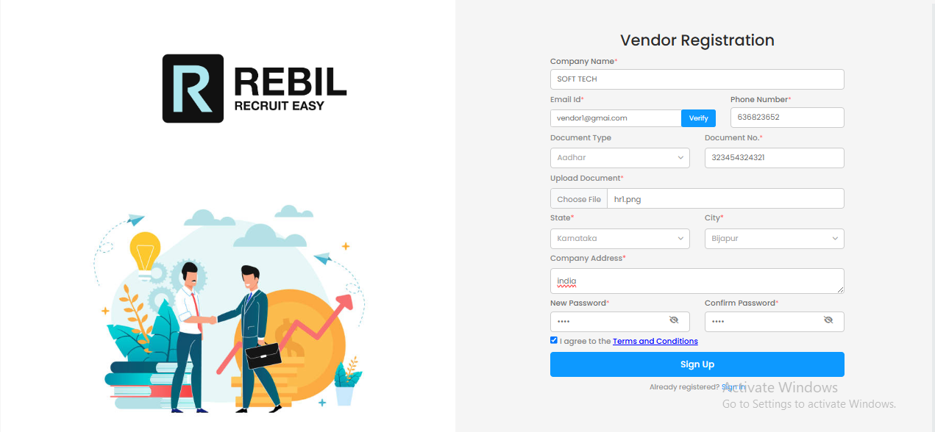
Vendor Registration
Screenshots

Slide 13
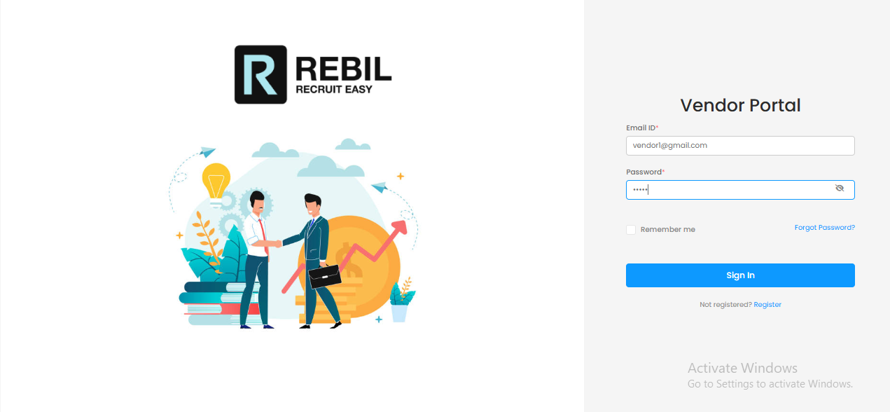
Vendor Login Portal

Slide 14
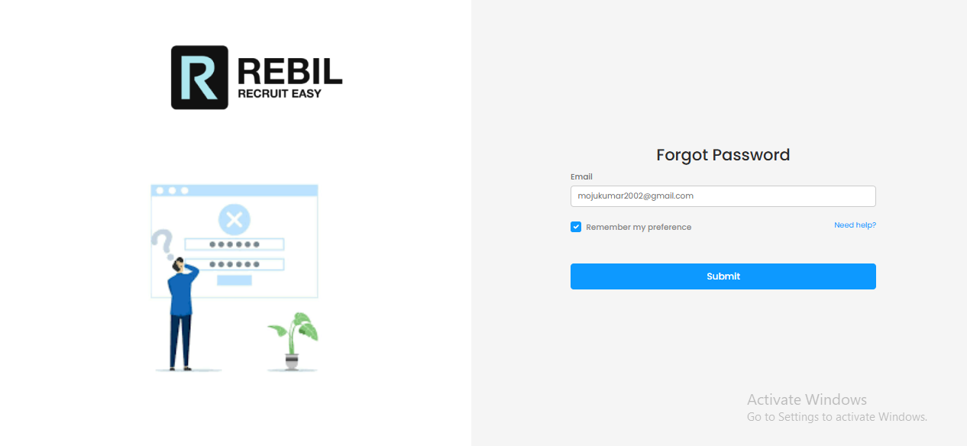
Forgot Password

Slide 15
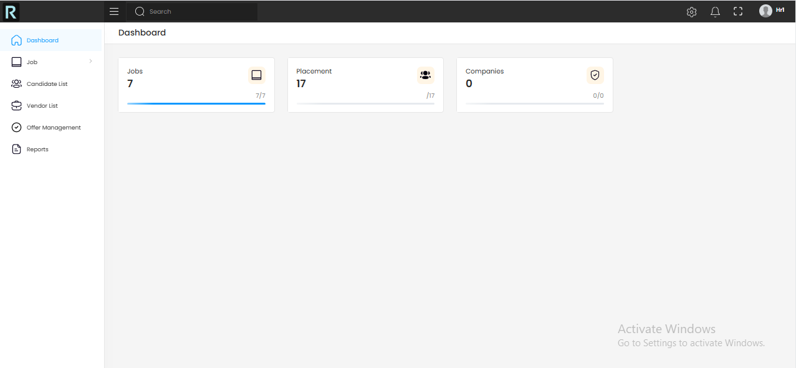
Vendor Dashbord

Slide 16
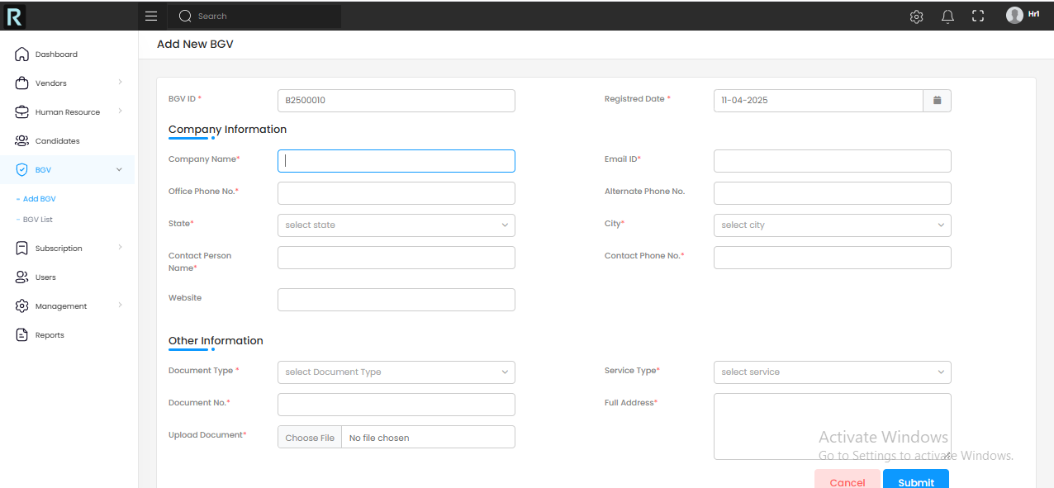
Adding Background Verification

Slide 17
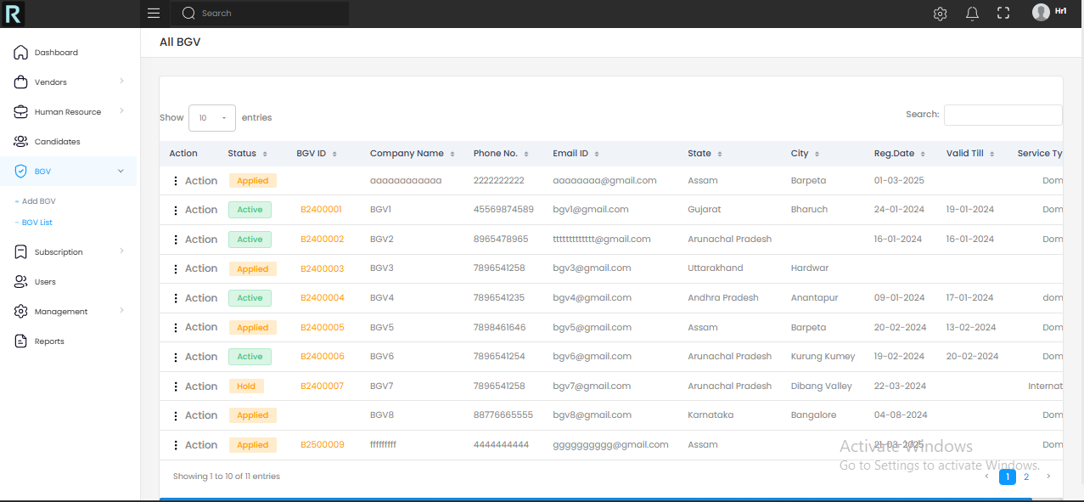
Background Verification List

Slide 18
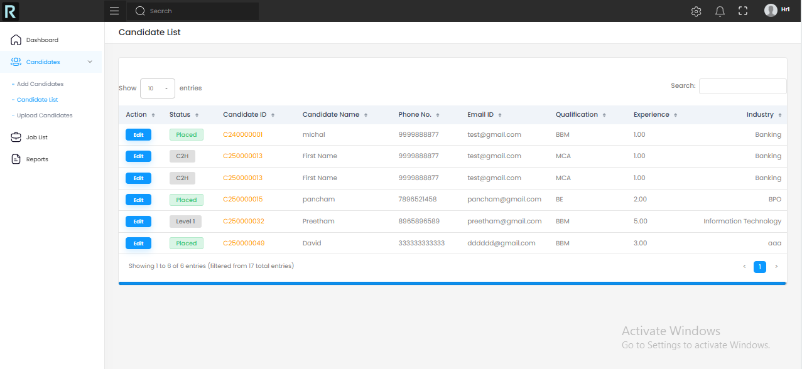
Candidate list

Slide 19
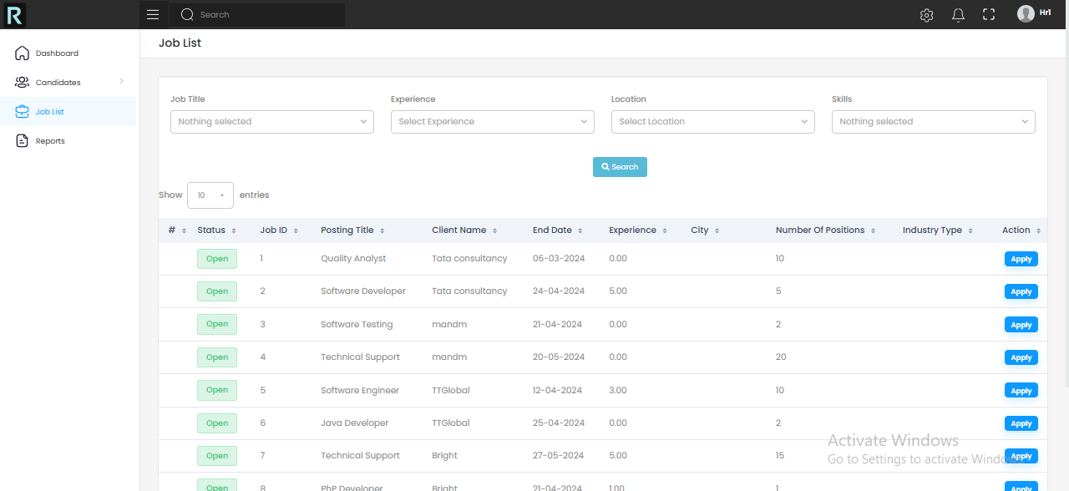
Job List

Slide 20
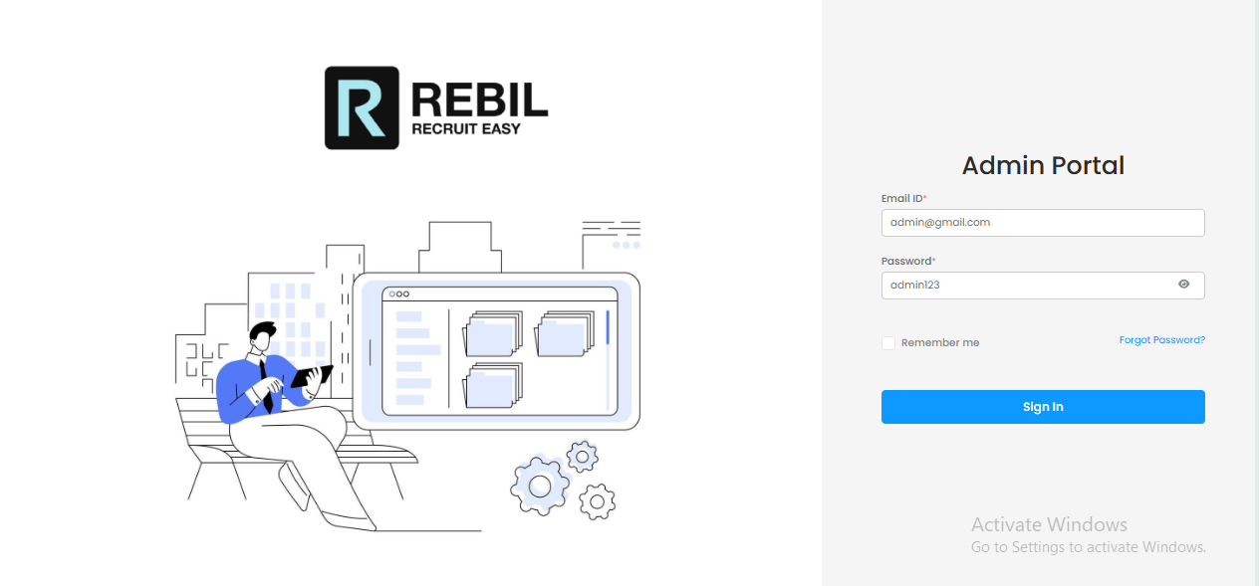
Admin Login

Slide 21
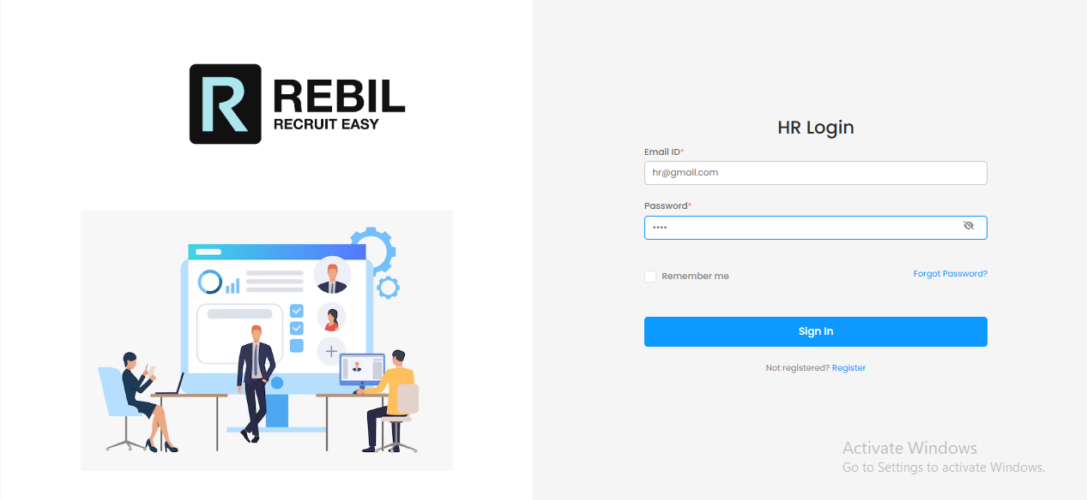
HR Login

Slide 22
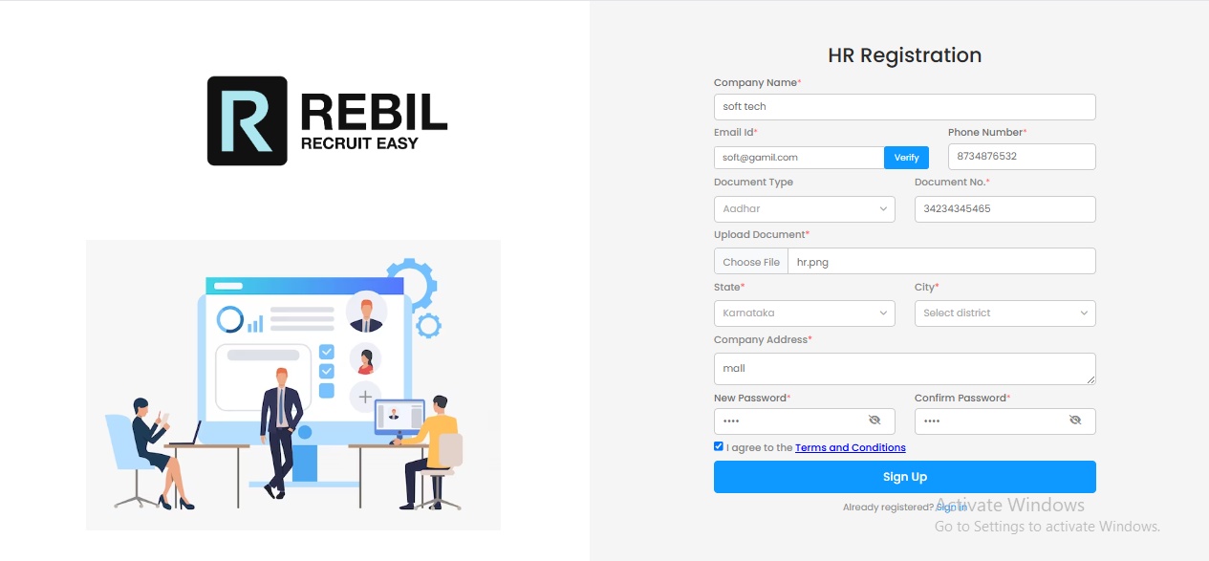
HR Register

Slide 23
References
AI-Driven Recruitment and Selection: Enhanced HR Decision-Making with Accrued Benefits of Organizational Success - ResearchGate
Blockchain-based Authentication and Verification System for Academic Certificate using QR Code and Decentralized Applications - ResearchGate
Artificial Intelligence and Automation in Human Resource Development: Evidence from Emerging Economies - SAGE Journals
Leveraging AI for Effective Human Resource Management - SSRN
Artificial Intelligence in Human Resource: The Key to Successful Recruiting and Performance Management - ResearchGate
The Future of HR: The Role of AI-Powered Recruitment in Shaping Organizational Success - SCIRP
The Adoption of Artificial Intelligence in Human Resources Management and its Impact on Organizational Efficiency - ScienceDirect

Slide 24
Github Link
GitHub Repository:
https://github.com/Mojukumar/Rebil

Slide 25


